Slide 1
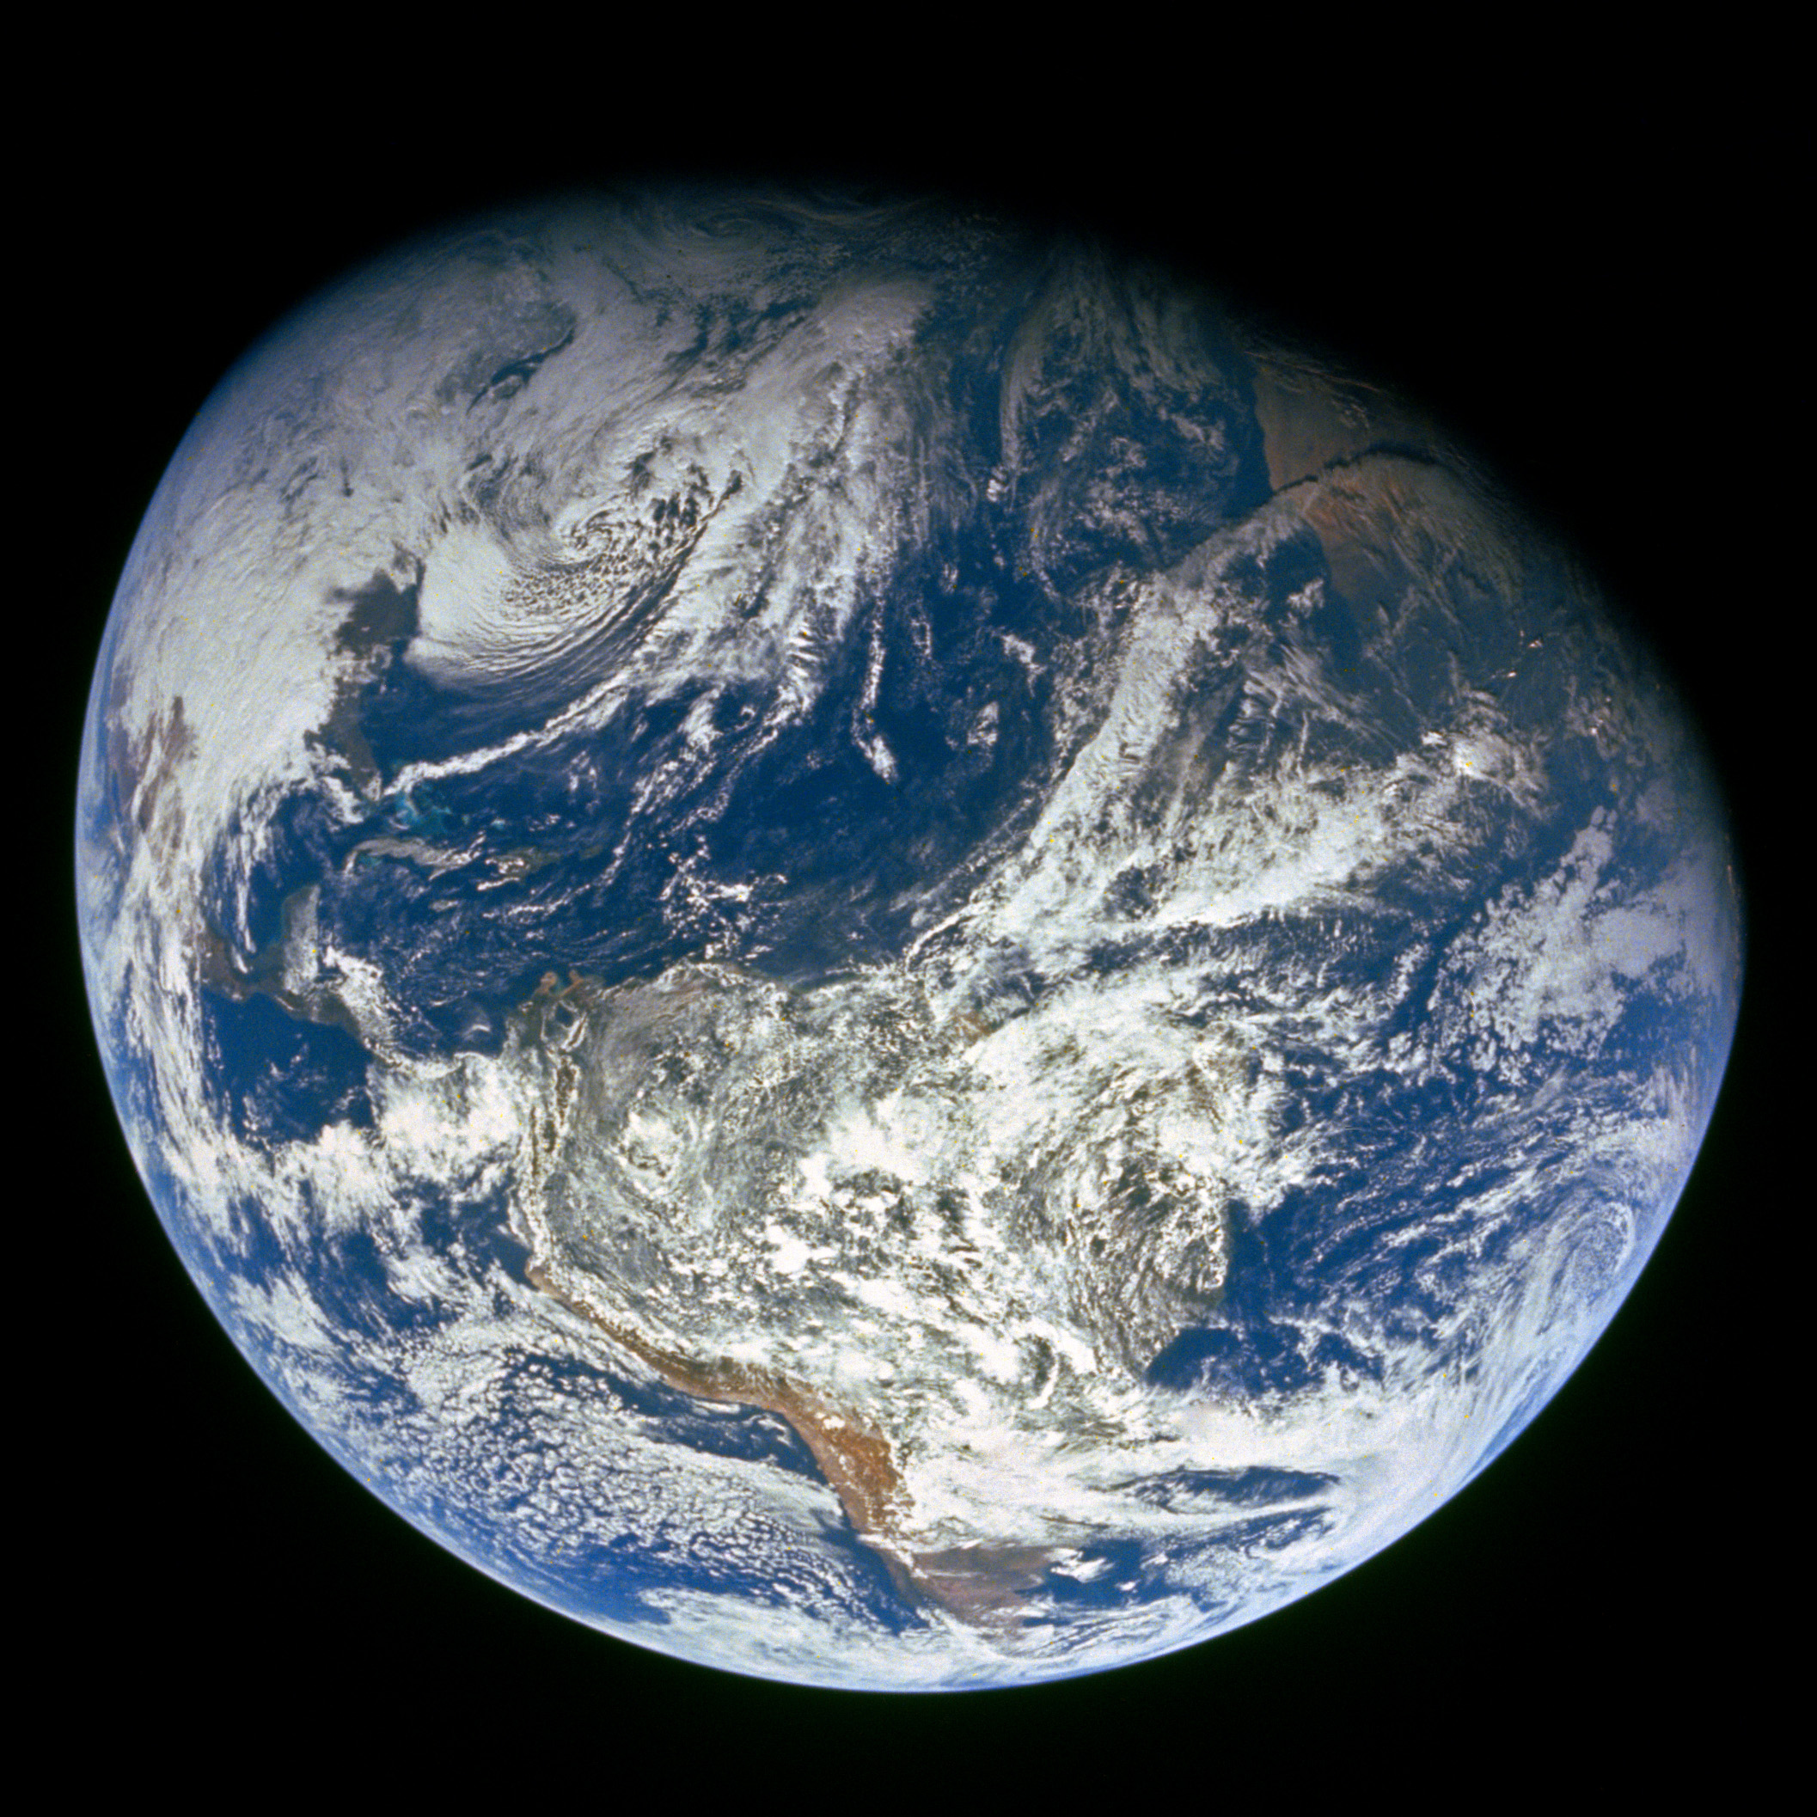
GENESIS
”In the beginning God…”

Slide 2
Four year study of the Bible - 17 Periods
1)
2)
3)
4)
5)
6)
7)
8)
9)
Genesis
10)
11)
12)
13)
14)
15)
16)
17)
Divided Kingdom
Judah Alone
Captivity
Return From Captivity
Years Of Silence
Life Of Christ
The Early Church
The Letters To The Christians
Before The Flood
The Flood
The Scattering Of The People
The Patriarchs
The Exodus
The Wandering In The Wilderness
Invasion & Conquest
Judges
United Kingdom

Slide 3
Genesis is Thrilling!
Un-”speak”-able Power! | War
Talking Serpent | Deceit
Murder | Ancient Civilizations
Mass Destruction | Incredible Wealth
Earth’s Origin | Man’s Origin
And it is all True!

Slide 4
Think Of The:
Power
Wisdom
Detail
Imagination
Speed

Slide 5
Outline Of Genesis
Genesis 1-11
  3 main stories [Creation, Flood, Scattering]
Genesis 12-50
  4 main characters [Abraham, Isaac, Jacob, Joseph]
  Divine promises are made and repeated to the Patriarchs (fathers)
  13 of the last 14 chapters focus on Joseph’s life

Slide 6
Overview Of Creation Days 1-6
Each creative day seems to follow a pattern (more or less)
  1) The Announcement “God said…”
  2) The Command “Let there be…”
  3) The Report “…And it was so”
  4) The Evaluation “…It was good”
  5) The Time Framework “Evening and morning were the …day”

Slide 7
Creation Days
Day 1 – Light
Day 2 – Firmament
Day 3 – Land, Sea, and Plants
Day 4 – Sun, Moon, and Stars
Day 5 – Sea Creatures and Birds
Day 6 – Land Animals and Mankind
Day 7 – God Rested

Slide 8
Context
Who?
God
When?
Today we start with the 3rd day of Creation
“Before the Flood” – 17 Periods
The earth was created roughly 6000 years ago

Slide 9
Creation Days
Day 3 (Land, Seas, Plants) 1:9-13
  God gathered the waters below the firmament/heaven into seas…land now became visible vv. 9-10
  All land vegetation ordered to sprout, yield seed, bear fruit vv. 11-12
    Plants began the process of growing & producing “…according to its kind” (10 times)
    Laws of nature (germination) enacted cp. Mk 4:26-28
Notes:
Was every breed of dog on Noah’s ark? No, but dogs of some fashion were on the ark.
God could have created EVERY variation of animal and plant during these 6 days BUT he didn’t. He created EVERY kind of animal and plant. He designed animals and plants to be able to vary. And to me that’s even more powerful!
Notice that everything process “after their kind”. You can’t plant watermelons and get strawberries. You don’t create men from apes.

Slide 10
Creation Days
Day 4 (Sun, Moon, Stars) v14-19
  God fills the firmament/heaven (1:6)
  Lights made to govern…Sun for the Day, and Moon for the Night v. 14a
  Another textual reason to reject the Gap Theory….eons can’t exist between Day 3 (plants) and Day 4 (Sun). Plants require light for photosynthesis
  Signs, Seasons and planetary interaction (rotation, orbit, tides, etc.) v. 14b John 20:30-31 Ps 19:1-6

Slide 11
Day 4 Sun, Moon, Stars
Planet | Distance From Earth (Miles)
Venus | 24 Million
Mars | 35 Million
Mercury | 57 Million
Pluto | 94.5 Million
Jupiter | 500 Million
Saturn | 746 Million
Uranus | 1.7 Billion
Neptune | 2.7 Billion
Notes:
NASA's space probe Voyager 2 left Earth in 1977 in an effort to reach the far-away planets and gather information. Twelve years later, in 1989, Voyager 2 flew close enough to Neptune to take some breathtaking photos of the blue planet. Read More: https://www.grunge.com/857250/heres-how-many-years-it-would-take-to-travel-to-neptune/?utm_campaign=clip

Slide 12
Creation Days
Day 5 (Sea Creatures, Birds) v20-23
  “living creatures” (water creatures and birds) v. 20
    All sea life for the previously gathered seas (v. 10)
    All animal life for rivers, lakes, ponds
    All winged life for the firmament/heaven (v.7)
    The sea & air teemed with life “…after their own kind”
  God commanded, “Be fruitful, multiply, fill the waters & Earth” v. 22

Slide 13
Creation Days
Day 6 (Land Animals, Mankind) v1:24-31
  Animal life created for the land v.24
    All living beasts & crawling creatures were made “…after their own kind”
Notes:
Adam and Eve were vegetarians.

Slide 14
Creation Days
Day 6 (Land Animals, Mankind) v1:24-31
  Man Created
    Made in the image of God…not said about any other created thing
      (having intelligence, reason, human free will, an eternal soul)
    Given dominion/rule over all other creation
    “Male & Female” by Divine design Matt 19:4 (Present culture re: gender identity??)
    Commanded to be fruitful, multiply & fill the Earth
    Diet also restricted…only given plants to eat (vegetables and fruits)
Notes:
Adam and Eve were vegetarians.
Matt 19:4 And He answered and said to them, “Have you not read that He who ^{[a]}made them at the beginning ‘made them male and female,’

Slide 15
Creation Days
  Rev 10:5-6 And the angel whom I saw standing on the sea and on the land raised his right hand to heaven ⁶ and swore by him who lives for ever and ever, who created heaven and what is in it, the earth and what is in it, and the sea and what is in it, that there would be no more delay

Slide 16
Creation Days
Day 7 2:1-3
  God rested from His creative labors v. 2
    Not in the sense God was tired (weary)… “rested” in the sense He was done
    God blessed/sanctified the 7th day
    Later became a part of Israel’s covenant Law Ex 20:8-11

Slide 17
Creation Days
Day 1 – “And God saw the light, that it was good”
Day 2 –
Day 3 – “And God saw that it was good” (twice)
Day 4 - “And God saw that it was good”
Day 5 - “And God saw that it was good”
Day 6 - “And God saw that it was good”
Day 6 – “Then God saw everything that He had made, and indeed it was very good”

Slide 18
Creation: Thought Question
Can you imagine a world without:
  Other People?
  Houses?
  Cars?
  Roads?
  Boats? Boathouse?
  Garbage?
  Crowds?
  Artificial light?
  Signal Towers?
  McDonalds? Walmart?
Notes:
This was the world that Adam and Eve lived in. Yet, they had all they needed!

Slide 19
Creation Days
In 1 day God created the sun, moon, and the stars!
In 1 day man was created “fearfully and wonderfully” by God (Ps 139:14)!
https://www.youtube.com/watch?v=HHRM3Mwd63U

Slide 20
God Created It All For Man (Gen 1:27-29)
So God created man in His own image; in the image of God He created him; male and female He created them. Then God blessed them, and God said to them, “Be fruitful and multiply; fill the earth and subdue it; have dominion over the fish of the sea, over the birds of the air, and over every living thing that moves on the earth.”
And God said, “See, I have given you every herb that yields seed which is on the face of all the earth, and every tree whose fruit yields seed; to you it shall be for food.

Slide 21
The Garden of Eden Gen 2:4-25
Moses gives additional details re: creation…particularly Days 3 & 6
    No vegetation yet because no rain had fallen…no man to cultivate vv. 4-6
    God’s creation of man v. 7 1:27
      “Formed/Fashioned”…”breathed into his nostrils the breath of life”
      “Man became a living soul” Only God can give life!! Ps 139:14

Slide 22
The Garden of Eden Gen 2:4-25
God planted a garden eastward…in Eden vv. 8-14

Slide 23
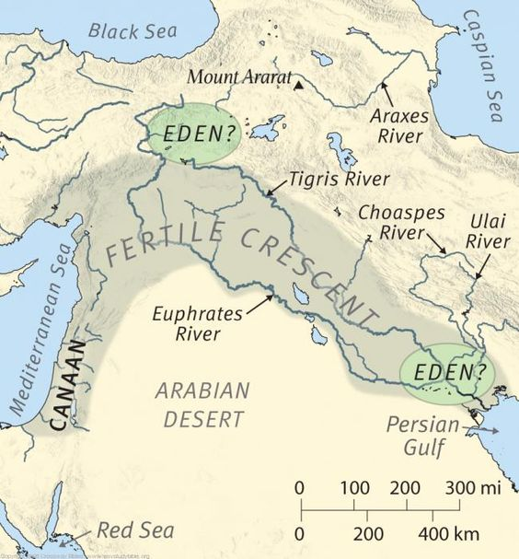
One river flowed out of Eden to water the garden. From there it divided into 4 rivers:
[1] Pishon
[2] Gihon
[3] Tigris
[4] Euphrates

Slide 24
The Garden of Eden Gen 2:4-25
God planted a garden eastward…in Eden vv. 8-14
  Every tree pleasing to the sight and good for food was provided
  Tree of Life was there…also Tree of Knowledge of Good and Evil
    God placed man man given a home
    God nourished the garden with water, food man given sustenance
    God commanded man to tend & keep the garden man given work
    God blessed man with Tree of Life man given eternal possibility
    God warned man re: Tree of Knowledge of Good & Evil man given a test

Slide 25
The Garden of Eden Gen 2:4-25
God’s final creative blessing to man…a companion vv. 18-25
  As of this point, man was all alone…God viewed this as “not good”
  Man needed a helper who was “meet” (suitable/comparable) v. 18
  The process by which God solved man’s problem of loneliness vv. 19-23
    God formed from the ground all animals (land & air)…brought them before man to see what he would name them
    Observing the animals singularly or in pairs, Adam (1st mention of his name) realized the companion he desperately needed was not among them
    Woman not made from the ground…she was created from & for man
    God brought her to Adam…he recognized her as his suitable companion

Slide 26
The Garden of Eden Gen 2:4-25
Foundation principle for marriage v. 24 Matt 19 Eph 5
Life started perfectly complete innocence… no guilt, no shame v.25
Notes:
Matt 19:4-6 ⁴ And He answered and said to them, “Have you not read that He who ^{[a]}made them at the beginning ‘made them male and female,’ ⁵ and said, ‘For this reason a man shall leave his father and mother and be joined to his wife, and the two shall become one flesh’? ⁶ So then, they are no longer two but one flesh. Therefore what God has joined together, let not man separate.”

Slide 27
Summary and Application
There is a God Genesis 1:1
God is powerful beyond our imagination! Gen 1
Marriage relationship is to be for life Matt 19:4-6
God Created EVERYTHING for man! Gen 1:27-30

Slide 28
Summary and Application
Man was created in the “image of God”
Eph 4:22-24 “to put off your old self, which belongs to your former manner of life and is corrupt through deceitful desires, and to be renewed in the spirit of your minds, and to put on the new self, created after the likeness of God in true righteousness and holiness.”

Slide 29
Follow-Up

Slide 30
God Breathed - Inspired
Gen 2:7 And the Lord God formed man of the dust of the ground, and breathed into his nostrils the breath of life; and man became a living being.
Job 27:3 As long as my breath is in me, And the breath of God in my nostrils,
Acts 17:25 Nor is He worshiped with men’s hands, as though He needed anything, since He gives to all life, breath, and all things.
Ps 104:29 You hide Your face, they are troubled;
You take away their breath, they die and return to their dust.

Slide 31
“Be Fruitful”
God’s command
  Gen 1:22 To water animals and birds
  Gen 1:28 To Man
  Gen 8:17 To the creatures coming off of Noah’s ark
  Gen 9:1, 7 To Noah and his sons after the flood
Used as a Blessing
  Gen 28:3 Isaac to Jacob
As a Promise to God’s People
  Jer 23:3

